Slide 1
Project Customer Segmentation ANALYSIS

Slide 2
Customer Segmentation Analysis
Subtitle: Understanding Your Customers to Drive Targeted Strategies
Team - PTID-CDA-NOV-24-248
TEAM MEMBER’s - Shubham Mohanty
Athira M

Slide 3
PROJECT OUTLINE
This project contains shopping information from 10 different shopping malls between 2021 and 2023
We have gathered data from various age groups and genders to provide a comprehensive view of shopping habits in Istanbul
The dataset includes essential information such as invoice numbers, customer IDs, age, gender, payment methods, product categories, quantity, price, order dates, and shopping mall locations

Slide 4

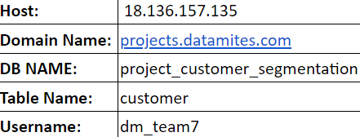
DATA SOURCES

Slide 5


DATA ANALYSIS
In a customer segmentation analysis project, data such as invoice numbers, customer IDs, age, gender, payment methods, product categories, quantity, price, order dates, and shopping mall locations.
The data should be analysis the outlined areas of focus,
1.How is the shopping distribution according to gender?
2.Which gender did we sell more products to?
3.Which gender generated more revenue?
4.Distribution of purchase categories relative to other columns?
5.How is the shopping distribution according to age?
6.Which age cat did we sell more products to?
7.Which age cat generated more revenue?
8.Distribution of purchase categories relative to other columns?
9.Does the payment method have a relation with other columns?
10. How is the distribution of the payment method?
The all above analysis are done in My SQL

Slide 6

ADVANCED ANALYTICS
Data Collection & Preprocessing: Gathering customer data from host id mentioned above and cleaning it for consistency and accuracy.
Behavioral & Psychographic Segmentation: Segmenting customers based on attitudes, values, and behaviors, in addition to transactional data, to uncover deeper insights.
Application & Optimization: Applying segmentation insights in targeted marketing, personalized offerings, and pricing strategies, while continuously monitoring and refining models for effectiveness.

Slide 7
CHALLENGES & SOLUTION
Challenges
Time constrain
Adapting to change
Risk management
Solution
Effective time management
Adaptability
Proactive risk planning

Slide 8

References
References & Tools Used:
My SQL
External libraries
Visualization tools (Power BI)
Presentation tools ( Power Point)

Slide 9
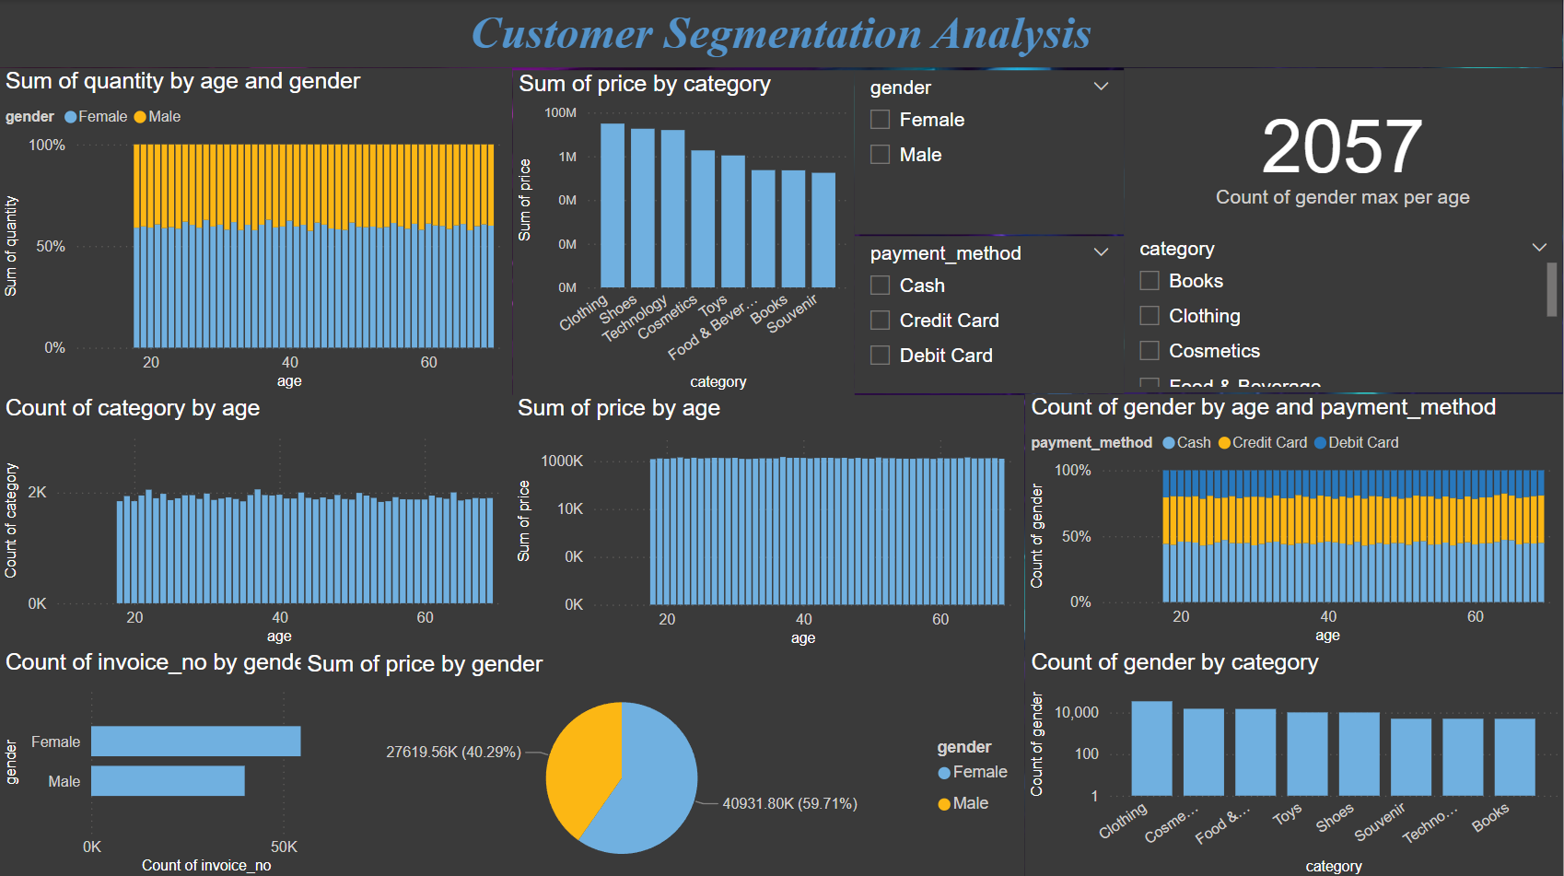

Slide 10
In an organization, any age or gender can be a potential customer. Customer behavior, purchasing habits, and preferences are not solely determined by these demographic factors. In fact, revenue doesn't discriminate by age or gender; it is the result of a combination of various factors, including product appeal, marketing strategies, and customer engagement.
A company can have a wide variety of customers spanning across different age groups and genders, each contributing to revenue in different ways. For example, younger customers might purchase trendy, low-cost items, while older customers might spend more on premium, high-quality products.
Like wise we will see how age and gender can be a potential customer.

Slide 11
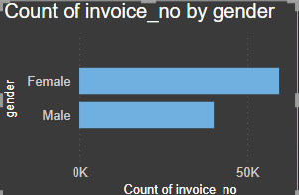
Shopping distribution to GENDER
Gender plays a vital role in shaping consumer behavior, preferences, and purchasing decisions.
Understanding gender dynamics is essential for any customer-centric organization because it allows businesses to tailor their strategies, marketing, and product offerings in a way that resonates with different customer groups.
Here's how gender impacts revenue:
The invoice counts of female customers i.e. 59482 no’s
and of male customers i.e. 39975 no’s. From here we can
get a all-around visual that female customers have done
more shopping and helped generation of more revenue
as compared to male.

Slide 12
Female customers make up the majority of the invoices, with 59,482 compared to 39,975 for male customers.
This indicates a strong engagement from the female demographic.
Actionable Strategy:
Focus on loyalty programs to retain female customers. Consider offering exclusive deals, birthday discounts, or personalized promotions.
Product diversification: Tailor product offerings to better serve the interests and preferences of female customers

Slide 13
Although Male customers represent a smaller segment, there’s a substantial number (39,975 invoices) that can be further engaged.
Actionable Strategy:
Targeted campaigns for male customers: Offer discounts on products that might appeal more to men
Use male-focused content in marketing campaigns, including social media ads, email newsletters, or influencer collaborations.

Slide 14
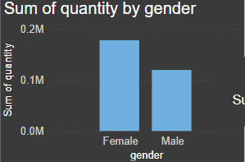
No. of products to gender
As we have already seen that female customer have done more shopping as compared to male customers. Sometimes it happens like less products generates more revenue based on more pricing so lets see which gender has bought more products.
Female customer have brought around 178659
Where as male have bought around 120053
So here also female customers have more contribution
in generating revenue.

Slide 15
Female-Dominated Market: With a significantly higher quantity of females compared to males (178,659 vs. 120,053), businesses can tailor their product offerings and marketing campaigns toward the female demographic.
Female-Centric Campaigns: Since women make up the larger segment, invest in targeted marketing campaigns (digital, print, social media) that resonate with female interests, values, and challenges. Focus on emotional connection, inclusivity, and empowerment themes.
Balance Male Engagement: While the male demographic is smaller, it still represents a significant portion of the customer base. Tailor marketing efforts to appeal more directly to male preferences, possibly highlighting practicality, innovation, or price sensitivity, depending on the product.
Male-Focused Initiatives: Develop campaigns targeting males that are personalized by their specific interests potentially boosting male customer engagement

Slide 16
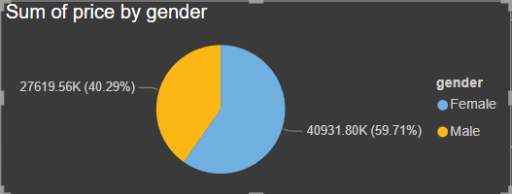
Gender to revenue
As female customer are more than male in count, so the revenue generated by female is quantitively more than male customers.
Total revenue is Rs. 6,85,51,365.91/-. The total price generated from female customers is significantly higher than from males (40,931,801.62 vs. 27,619,564.29). This indicates that while there are more females purchasing, they may also be purchasing higher-value products, contributing to a larger share of the revenue.
Insight: Businesses could focus on further maximizing their revenue from female customers by targeting high-value product categories, introducing premium offerings or enhancing the value proposition for female buyers.

Slide 17
Female Consumers Are Less Price-Sensitive: Since females are spending more overall, they may be less price-sensitive or more inclined to invest in higher-ticket products.
Actionable Insight: Consider introducing premium products, exclusive collections, or higher-margin items to appeal to this market segment. Focus on bundling, loyalty programs, or offering customized solutions that enhance perceived value.
Male Customers May Be More Price-Sensitive: The lower total spend from male consumers suggests that they could be more price-sensitive or more selective with their purchases.
Actionable Insight: Tailor marketing strategies for males by focusing on affordability, offering discounts, or emphasizing value for money. Consider introducing more budget-friendly or entry-level products that appeal to this group.

Slide 18
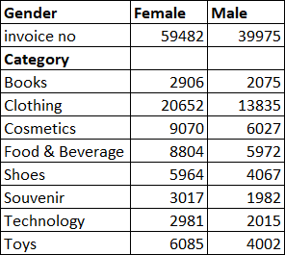
Purchase category relation
In any customer-centric organization, it's crucial to understand how gender influences purchasing behavior across different product categories. Gender and age often plays a significant role in shaping consumer preferences and purchasing patterns. Male and female may show varying interest in product categories, which can significantly impact the total quantity purchased by each gender.
Female Revenue Trends:
The highest revenue from female customers comes from age groups 37 years (957,105), 40 years (852,436), and 43 years (779,461).
Insight: Female customers in their late 30s and early 40s appear to have the highest purchasing power. This age group may be more financially stable, possibly having established careers and families, which means they may have higher disposable income.
Actionable Strategy: Focus marketing efforts on products that cater to this demographic luxury items. Tailor your offerings to their lifestyle needs, and use personalized campaigns that resonate with their values.
Count Of Gender

Slide 19
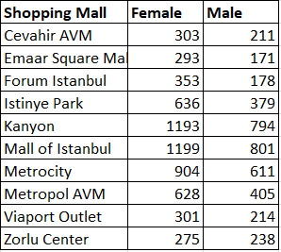
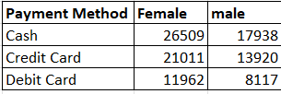
Male Revenue Trends:
The highest male revenue comes from age groups 37 years (532,138), 51 years (578,271), and 46 years (571,454).
Insight: Males in their late 40s and early 50s are major contributors to revenue, suggesting they are in their peak earning years.
Actionable Strategy: Offer premium products targeted at this age group. Marketing campaigns should highlight quality, durability, and long-term investment.
Purchase Behavior Analysis
Females in Age Group 37 (Highest Revenue) vs. Males in Age Group 37 (532,138): While both genders have significant revenue generation, the higher count of categories purchased by females (1,280) compared to males (777) suggests that females tend to purchase a wider variety of products or more frequently.

Slide 20
Age shopping distribution
Age has always been a factors for revenue generation. Total products sold was 2,99,000 no.s and total revenue was generated was Rs. 6,85,51,365.91/-
Key Age Groups with Highest Category Counts : Age 37 (2,057), Age 43 (2,000), and Age 64 (2,002) have the highest counts of categories. These groups are engaged in purchasing a large number of different products.
Insight: These age groups represent a high level of engagement and diversity in purchasing behavior, indicating that they are active and willing to explore a wide variety of products.
Actionable Strategy: Tailor marketing campaigns and offers specifically for these age groups. Promote a wide range of products or create bundles that cater to various needs.
Younger Demographics (18-30):Age groups 18 (1,844), 19 (1,936), 20 (1,844), and 21 (1,947) exhibit high engagement, showing that younger consumers are actively purchasing across many categories.
Insight: Younger consumers are likely experimenting with a variety of products. They may be open to exploring new trends and discovering products across categories
Actionable Strategy: Focus on trend-driven products that cater to the interests of this demographic. Consider using influencer marketing or social media campaigns, highlighting trending products or limited-time offers that appeal to their curiosity and exploration.

Slide 21
But as all know that age plays a crucial role for business. So which particular age with respect to gender gave more revenue in which category in following table:-
| FEMALE | MALE |
FEMALE | MALE
CATEGORIES | AGE | REVENUE | AGE | REVENUE
Clothing | 37 | 4,12,910.08/- | 43 | 284776
Cosmetics | 32 | 24,802.60/- | 33 | 16955
Food and Beverages | 37 | 3321.05/- | 23 | 2202
Toys | 27 | 15232.00/- | 21 | 10931
Shoes | 37 | 268876.00/- | 29 | 174049
Souvenir | 24 | 2616.00/- | 18 | 1853
Technology | 30&65 | 234150.00/- | 66 | 161700
Books | 36 | 3348.00/- | 24 | 2485

Slide 22
Stable Purchase Patterns (30-50 years):Age groups between 30 and 50 show consistent engagement, with categories ranging from 30 (1,981) to 50 (1,873). These consumers tend to engage with multiple categories, indicating steady purchasing habits.
Insight: This group is likely in a phase of financial stability, balancing both personal and family needs, and thus is actively engaged in multiple product categories.
Actionable Strategy: Offer products that cater to both personal enrichment and family needs. Consider loyalty programs or bundled discounts to further engage them.
Engagement in Older Consumers (50+ years):Age groups 51 (1,993), 56 (1,916), and 60 (1,874) show high engagement in a wide variety of categories, suggesting that older consumers are also interested in exploring different products.
Insight: These consumers may prioritize comfort, health, and leisure, and could be looking for products that enhance their well-being, home life, and retirement planning.
Actionable Strategy: Create marketing strategies that emphasize comfort, quality, and convenience, such as healthcare products, leisure activities, home improvement, or travel. Offer subscription services or loyalty programs that cater to their lifestyle

Slide 23
Age to productivity
Young Adult Population (18-25) is Largest:
The age group 19-22 shows the highest number of individuals in your dataset, with counts ranging from 1844 to 2051. This suggests that the 18-25 age group is a dominant segment in your market.
Key insight: This group is likely in the early stages of their careers or education, making them highly influential in terms of trends, purchasing behavior, and social media engagement.
Stable Demand Among Adults (26-45):
The 26-45 age group (from 26 to 45) shows relatively stable numbers, with counts between 1863 and 2057, indicating a broad adult market that has consistent demand for products or services.
Key insight: This segment is likely to be more financially stable than younger individuals, potentially making it a key market for higher-value products or services.
Decline After 45:
From age 46 onward, there's a noticeable decline in the number of individuals within each age bracket, with the lowest counts seen in the 50-69 age range (averaging between 1800-1900).
Key insight: While not negligible, this age group might represent a smaller proportion of the target market, suggesting a shift towards younger adults and middle-aged consumers in terms of purchasing power.

Slide 24
Particular age to revenue
Now we will see which age generated more revenue , so that it will easy for organization to focus on all-around development. For female 37 aged generated Rs. 9,57,104.74/- and for male 27 aged generated Rs. 5,99,023.62/- . In order to know how many female and male are there in above age and break-up of above generated revenue in the table below:-
| Female | Male |
CATEGORY | REVENUE | GENDER COUNT | REVENUE | GENDER COUNT
Clothing | 412910 | 454 | 254768 | 271
Cosmetics | 23623 | 187 | 15369 | 128
Food and Beverages | 3321 | 206 | 1883 | 110
Toys | 12150 | 126 | 7921 | 74
Shoes | 268876 | 137 | 173449 | 92
Souvenir | 1947 | 54 | 1349 | 37
Technology | 232050 | 67 | 142800 | 42
Books | 2227 | 49 | 1485 | 36

Slide 25
Actionable Steps
Target Younger Demographics (18-25):
Focus on digital platforms like social media, influencer marketing, and platforms like TikTok and Instagram, where younger consumers are most active.
Offer student discounts, early-career professional development tools, or subscription models that align with their financial capabilities and needs.
Create Products/Services for 26-45 Age Group:
This group might have more stable financial resources, making them suitable targets for premium offerings, long-term investments, and luxury products. Think about targeting this demographic with financial planning services, home goods, wellness products, and advanced tech gadgets.
Develop loyalty programs, subscription models, or personalized offerings that appeal to their busy and evolving lifestyles.

Slide 26
Tailor Marketing and Customer Engagement Strategies:
Content marketing: Create tailored content that resonates with each age group. For younger audiences, focus on trend-related content, for mid-aged adults, offer practical and lifestyle-centric content, and for older customers, prioritize educational and value-driven content.
Cross-channel communication: Leverage multiple communication channels (email, social media, SMS, etc.) to ensure that all segments are effectively engaged.
Particularly men aged 22 bought 2530 no.s, generating revenue around Rs. 5,62,583.31/- and female aged 37 bought 3913 no.s with a revenue around Rs. 9,57,104.74/-. Lets see briefly how much gender-count related to product as per the above ages.
Category | Male | Female
Clothing | 291 | 454
Cosmetics | 121 | 187
Food and Beverages | 124 | 206
Toys | 97 | 126
Shoes | 75 | 137
Souvenir | 41 | 54
Technology | 47 | 67
Books | 47 | 49

Slide 27
Young Adult Population (18-25) is Largest:
The age group 19-22 shows the highest number of individuals in your dataset, with counts ranging from 1844 to 2051. This suggests that the 18-25 age group is a dominant segment in your market.
Key insight: This group is likely in the early stages of their careers or education, making them highly influential in terms of trends, purchasing behavior, and social media engagement.
Stable Demand Among Adults (26-45):
The 26-45 age group (from 26 to 45) shows relatively stable numbers, with counts between 1863 and 2057, indicating a broad adult market that has consistent demand for products or services.
Key insight: This segment is likely to be more financially stable than younger individuals, potentially making it a key market for higher-value products or services, including financial services, home goods, and more.

Slide 28
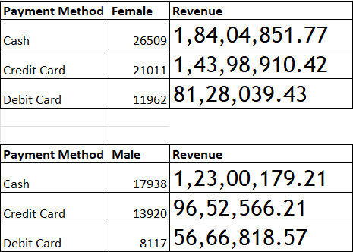
Payment methods dependency
As we know where revenue is generated, there payment are done with various methods. Here the customer have paid in Cash, Credit card, Debit card. In which age, gender, total amount, are inter-linked. On the below table we will see how they are inter-linked

Slide 29
Cash Payments Are Popular Across All Age Groups (Especially Middle-Aged Adults)
Cash is the most commonly used payment method for all age groups, with many individuals, especially between 18-69 years, using cash for their purchases. For instance, 41-year-olds and 22-year-olds show high counts of cash transactions.
Insight: This indicates that a significant portion of consumers still prefer paying in cash, suggesting that businesses should continue to accommodate this payment method, especially for certain demographics.
Credit Cards Are Popular in Certain Demographics
Credit cards are frequently used by middle-aged to older consumers (e.g., 50, 51, 57, 58 years), with 43-year-olds and 64-year-olds notably using them.
Insight: Credit card usage might be linked to higher-value purchases, indicating that consumers in these age groups may have more disposable income or prefer the benefits of credit.
Debit Card Usage Is Less Common, But Present Among Younger Consumers
Debit cards are less frequently used overall, but there is some presence in the younger age groups like 18-24 years. 18-year-olds and 21-year-olds have relatively high debit card usage.
Insight: Debit card usage among younger consumers may be due to the nature of their spending habits or a lack of credit availability. This group is likely more financially cautious, preferring to spend only what they have.

Slide 30
Age Groups with Higher Quantities of Products Purchased
Higher purchase quantities are seen with middle-aged to older adults. For example, 36-year-olds have a product quantity of 221, while 50-year-olds have 213.
Insight: Consumers in their 30s to 50s seem to make larger purchases in terms of quantity, which could indicate bulk buying, a preference for value deals, or family-related purchases.
5. Gender-Specific Trends
There is a clear trend that females are purchasing more frequently than males in many age groups. For example, the 29-year-old females have purchased 195 units, while males of the same age purchased 119.
Insight: Female consumers seem to have a higher purchasing frequency than their male counterparts, which could be relevant for product targeting and marketing efforts.\
As we all saw how gender is linked with the payment method. But as payment method is linked so lets see from which gender of what particular age has used which for total price
FEMALE | MALE
Payment methods | Age | Price | Age | Price
CASH | 37 | 4,65,019/- | 64 | 2,78,881/-
CREDIT CARD | 46 | 3,40,622/- | 27 | 2,23,129/-
DEBIT CARD | 51 | 2,12,449/- | 43 | 1,39,307/-

Slide 31
As we already know gender is linked to revenue. Now we will see the gender count for each category against payment method
| FEMALE GENDER COUNT |
CATEGORY | CASH | CREDIT CARD | DEBIT CARD
Clothing | 214 | 163 | 100
Cosmetics | 100 | 78 | 49
Food and Beverages | 102 | 74 | 49
Toys | 69 | 59 | 33
Shoes | 72 | 59 | 30
Souvenir | 42 | 32 | 21
Technology | 37 | 31 | 27
Books | 39 | 29 | 21

Slide 32
| MALE GENDER COUNT |
CATEGORY | CASH | CREDIT CARD | DEBIT CARD
Clothing | 145 | 112 | 69
Cosmetics | 68 | 56 | 34
Food and Beverages | 67 | 59 | 32
Toys | 55 | 37 | 27
Shoes | 44 | 37 | 29
Souvenir | 25 | 25 | 16
Technology | 24 | 22 | 14
Books | 26 | 23 | 15

Slide 33
FINDINGS
The shopping Distribution according to gender female are higher comparing male
Female are sell more products
According to gender female are generated more revenue
Distribution of purchase categories relative to other columns finding
In the dataset 37 age are higher shopping distributed
36-50 age sell more products
Age of 37 aged female generated more revenue
Distribution of purchase categories relative to other columns finding
Different payment methods are using according different columns
Cash are highly use to payment method

Slide 34
CONCLUSION
In a Conclusion From the dataset containing invoice numbers, customer IDs, age, gender, payment methods, product categories, quantity, price, order dates, and shopping mall locations, several valuable insights can be drawn to inform business strategies. Analyzing the payment methods reveals customer preferences, allowing businesses to optimize payment options and reduce transaction costs. Age and gender analysis uncovers distinct purchasing patterns, helping to tailor marketing campaigns and product offerings to different demographics. Examining product categories helps identify high-revenue-generating items, guiding inventory management and promotional strategies. The study of shopping mall locations highlights regional differences in customer behavior, enabling businesses to prioritize successful areas for expansion or marketing.

Slide 35
Target High-Engagement Age Groups (37-43 years, 64 years): These groups have high engagement levels and are great targets for broad product offers and personalized marketing.
Personalize Offerings for Younger Consumers (18-30 years): Cater to their curiosity and trend-driven preferences with a wide variety of products and influencer-led campaigns.
Simplify the Shopping Experience for Older Consumers (50+ years): Focus on comfort, ease of use, and personalized products, especially for those aged 60+.
Leverage Cross-Selling and Bundling: Younger consumers are more likely to purchase across categories, so bundle products to increase their cart size and explore cross-sell strategies.
Optimize Campaign Timing and Seasonal Offers: Plan promotions and product offers that align with specific age groups' needs throughout the year.
By focusing on these insights, you can enhance customer engagement, boost sales, and create more targeted, effective marketing campaigns that cater to the specific needs of each age group.
By leveraging these insights, businesses can better target their audience with tailored products, payment options, and marketing campaigns.
Understanding age and gender trends, combined with payment method preferences, allows businesses to refine their strategies for maximum engagement and sales.

Slide 36

Thank You!!

